Slide 1
Course Introduction
Paul Kim

Slide 2


About Me
Name: Paul Hyunjin Kim
Assistant Professor at Bridgewater State University
Ph.D. from The Ohio State University
Research about maze generation
Maze
Game Level

Slide 3
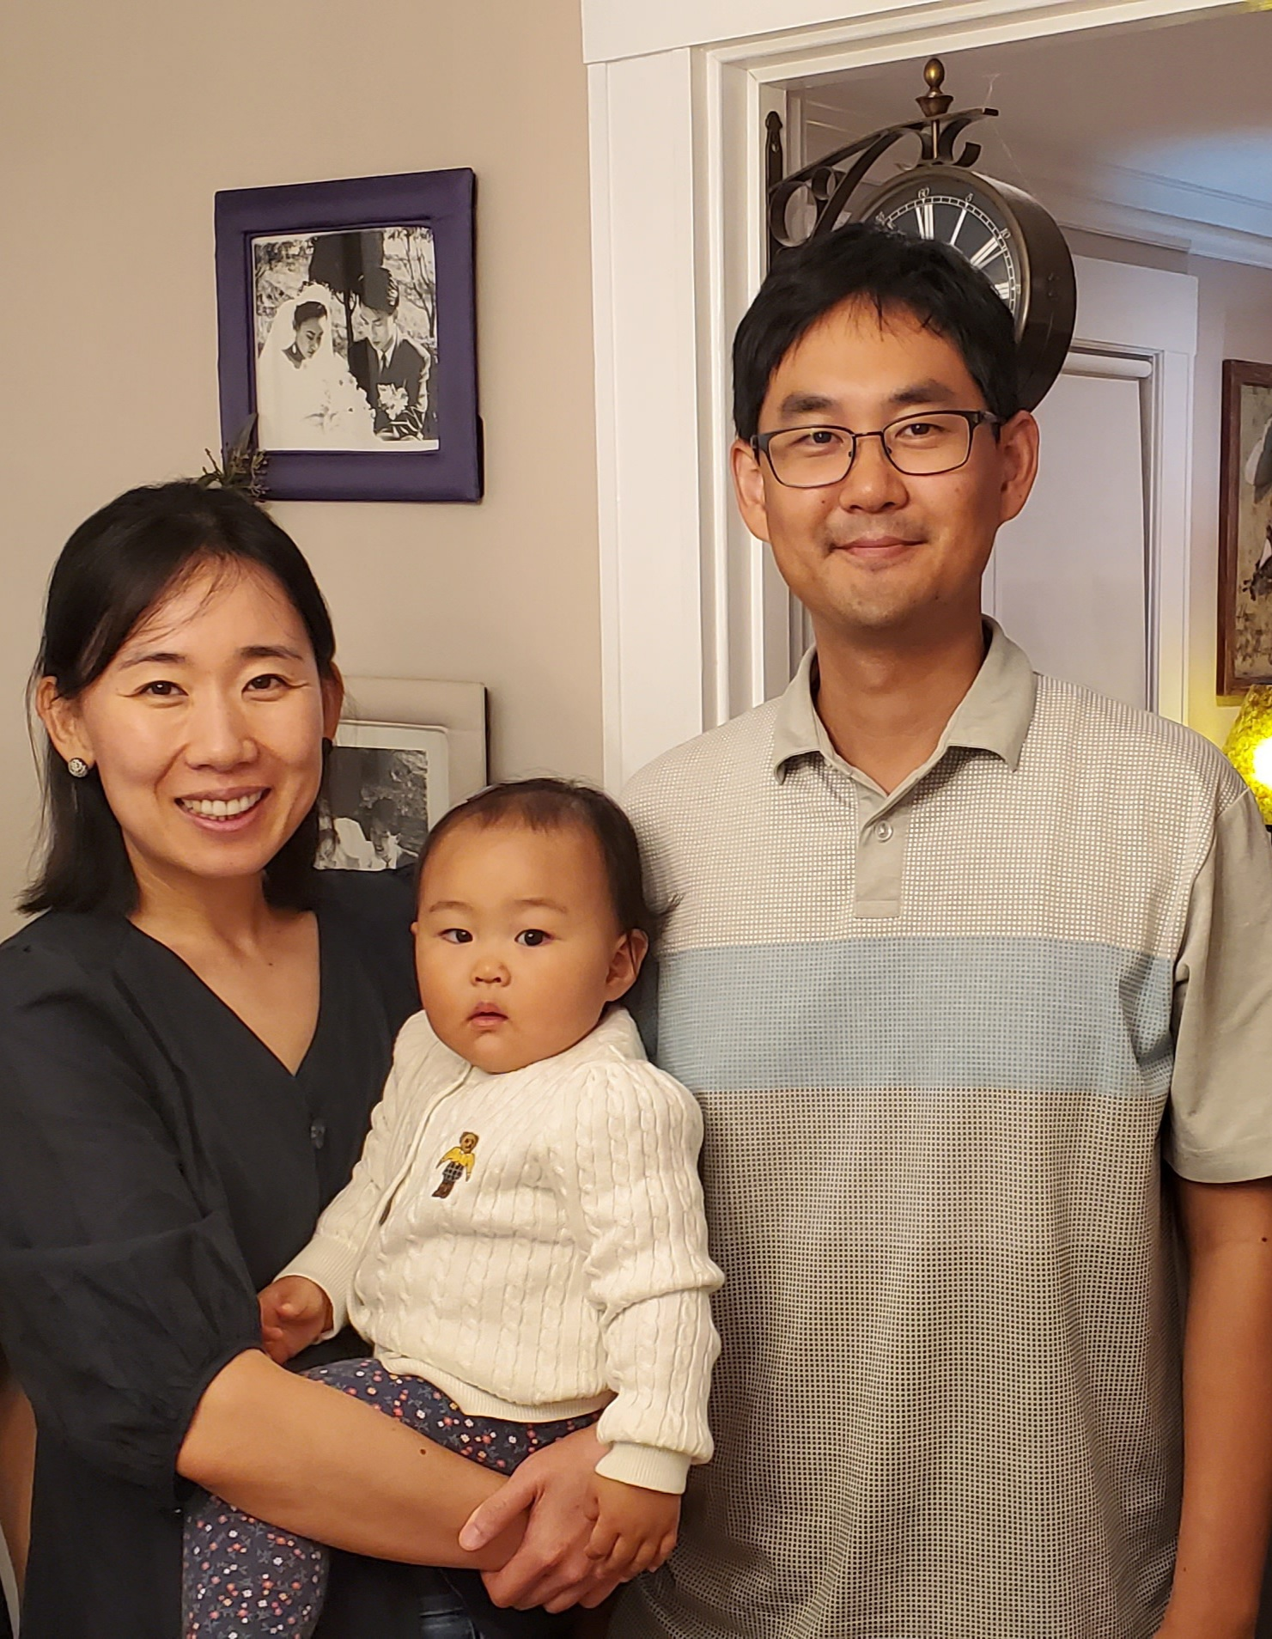
About Me
Family Picture

Slide 4
About this Course
COMP 340: Organization of Programming Languages
Class Time
MW 12:20 pm – 01:35 pm
Classroom
Zoom meeting room (link is on Blackboard)

Slide 5


About this Course
What do we learn in this course?
Programming Language Itself
What is programming language?
Language that enables us to communicate with computer
Source Code

Slide 6
About this Course
What do we learn in this course?
Programming Language Itself
What is programming language?
Language that enables us to communicate with computer
Source Code
C
C++
Java
Python
…..
Programming Language

Slide 7


About this Course
Why do we learn programming language itself?
Better understanding of tool
Better usage of tool
Mario Fusco 🇪🇺 on Twitter: "Using the wrong algorithm or an inappropriate data structure is like cutting a steak with a screwdriver: the result will require a much bigger effort and won't be aesthetically pleasant https://t.co/FX4dkb6rqB" / Twitter
http://www.defininghopes.com/using-the-wrong-tools-or-the-right-tools-the-wrong-way/

Slide 8
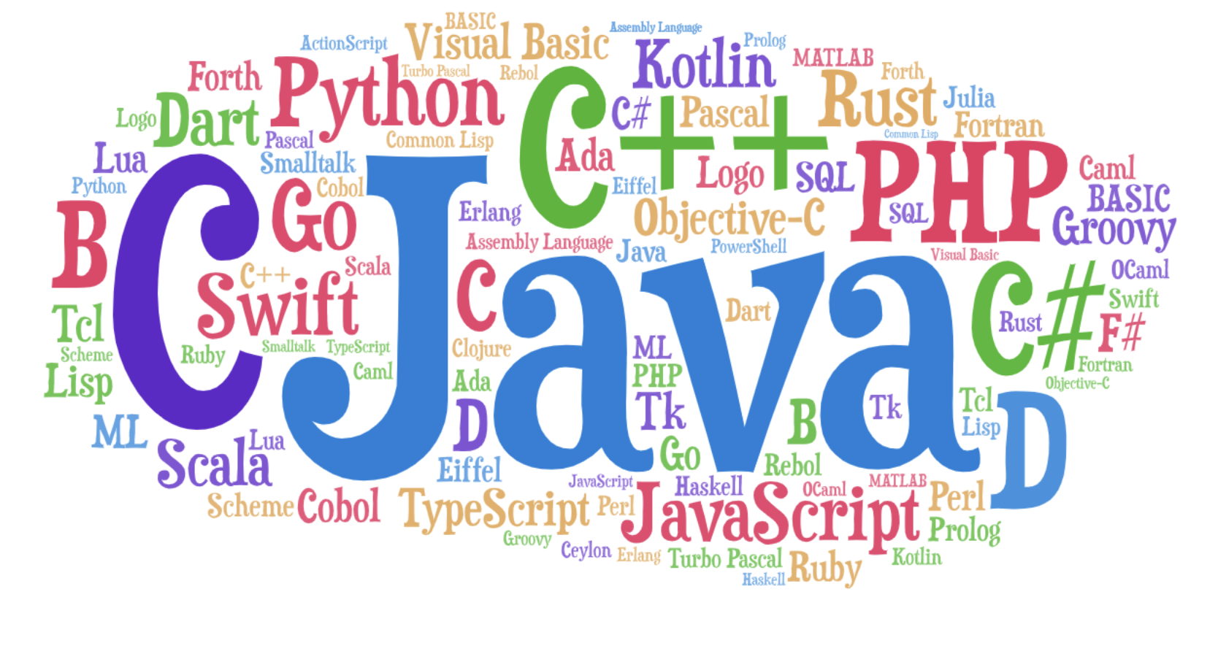
About this Course
Why do we learn programming language itself?
Establishing common knowledge over programming languages
Being confident at learning new programming languages
https://medium.com/javarevisited/70-years-of-hello-world-with-50-programming-languages-2400de893a97
Notes:
Will learn concepts found in various languages

Slide 9
About this Course
Overview of Covered Topics
This course has three parts
Part 1: General Concepts in Programming Languages (handle Python & Java especially)
Type (ex. data types: int, string…)
Control Flow (ex. while, if …)
Object-Oriented Programming
Notes:
Will be like reviewing already known concepts differ

Slide 10
About this Course
Overview of Covered Topics
This course has three parts
Part 2: Different Programming Paradigms
Functional Programming (Racket)
Logic Programming (Prolog)
Notes:
Will learn concepts found in various languages

Slide 11
About this Course
Overview of Covered Topics
This course has three parts
Part 3: Studying of how computer executes source code
Syntax Analysis
Semantic Analysis
Notes:
Will learn concepts found in various languages

Slide 12
Course Overview (Tentative)
Homework
Exams
Final Project
Grading Policy

Slide 13
Homework
Seven Homework
Combination of various type of questions
True/False questions
Short answer questions
Programming exercises
No late submissions!
…..

Slide 14
Exams
Two Midterms
For each, one day to work on

Slide 15
Final Project
Implement very very very very simple simple simple mini mini mini language
One month to work on
No late submission!

Slide 16
Grading Policy
Homework (40%)
Midterms (30%)
Final Project (30%)
+ Attendance (2%) (maybe…)

Slide 17
Academic Dishonesty
Assignments should be your own work
Do NOT share your assignments with others
Do NOT copy others’ assignments
Discussion should be limited to IDEA not answers
VERY IMPORTANT!!!!

Slide 18
Textbook
No specific textbook
Necessary reading resources will be provided

Slide 19
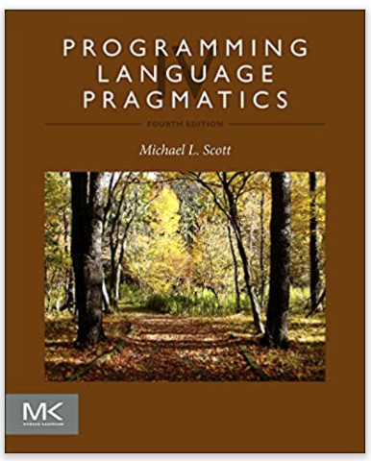
Textbook
Reference
Programming Language Pragmatics 4th Edition
by Michael L. Scott

Slide 20
Programming Environment
IDE (Integrated Development Environment)
Can use whatever you want
Command-Line Tool
Used to run program
Git
Used to submit programming assignments

Slide 21
Course Schedule

Slide 22
Blackboard & Syllabus

Slide 23

I am here to help you
Ask questions as many times as possible (during class and via email)
Don’t feel afraid…
Come to office hours as many times as possible
Don’t feel afraid…

Slide 24
I am here to help you
Office Hours
MTWR 3:30pm-4:30pm
Zoom meeting room (link is on Blackboard)
Email: p2kim@bridgew.edu

Slide 25

Welcome
https://memegenerator.net/instance/66586132/game-of-thrones-brace-yourselves-spring-semester-is-coming

